Slide 1
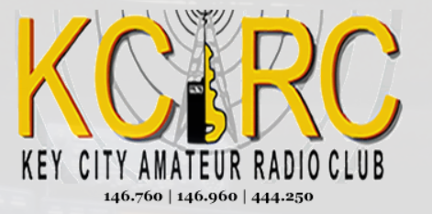
FREE CLASS FOR THOSE WANTING TO OBTAIN AN AMATEUR RADIO LICENSE (HAM RADIO) GENERAL CLASS
Session | Date | Topic
1 | 2/3 | Introduction, HF and Emergency Operating Techniques
2 | 2/10 | Rules and Regulations, Licensing and Privileges, Technical Standards
3 | 2/17 | Components and Circuits, Power and Decibels, AC Power, Basic Components
4 | 2/24 | Reactance and Impedance, Active Components, Practical Circuits, Basic Test Equipment
5 | 3/2 | Radio Signals and Equipment, Modes and Bandwidth, Radio’s Building Blocks, Transmitters and Receivers, HF Station Installation
6 | 3/9 | Basic, Character, Packet Based Digital Modes, Receiving and Transmitting Digital Modes, Digital Operating Procedures
7 | 3/16 | Antennas, Dipoles, Ground-planes, Yagi, Loop and Specialized Antennas, Feed Lines
8 | 2/23 | Propagation, The Ionosphere, The Sun and Scatter Modes
9 | 3/30 | Electrical and RF Safety, RF Exposure and Outdoor Safety
TEST | 4/6 | License testing day at Abilene Library South Branch at the Mall 4310 Buffalo Gap Road, Abilene, Tx.
SATURDAYS FROM 1 PM TO 5 PM AT CISCO COLLEGE
717 E. INDUSTRIAL BLVD, ABILENE, TX 79602
Questions or sign up: call or text 325-338-0939.

